Slide 1
BST 260 Introduction to Data Science
Heather Mattie
hemattie@hsph.harvard.edu

Slide 2
Today
What is Data Science?
Why learn Data Science?
How do we learn Data Science?
Who is helping you learn Data Science?

Slide 3
20th Century Innovation
Engineering and Computer Science played key roles
Cars
Airplanes
Power grid
Television
Air conditioning and central heating
Nuclear power
Digital computers
The internet

Slide 4
But what about these 20th century questions?
Does fertilizer increase crop yields?
Does Streptomycin cure Tuberculosis?
Does smoking cause lung-cancer?

Slide 5
What is the difference?

Slide 6
What is the difference?
Deterministic versus random
Deductive versus empirical
Solutions deduced mostly from theory versus solutions deduced mostly from data

Slide 7
Data
Does fertilizer increase crop yields?
Answer: Collect and analyze agricultural experimental data
Does Streptomycin cure Tuberculosis?
Answer: Collect and analyze randomized trials data
Does smoking cause lung-cancer?
Answer: Collect and analyze observational studies data
Analyzing these was the job of: boring ol’ statisticians

Slide 8
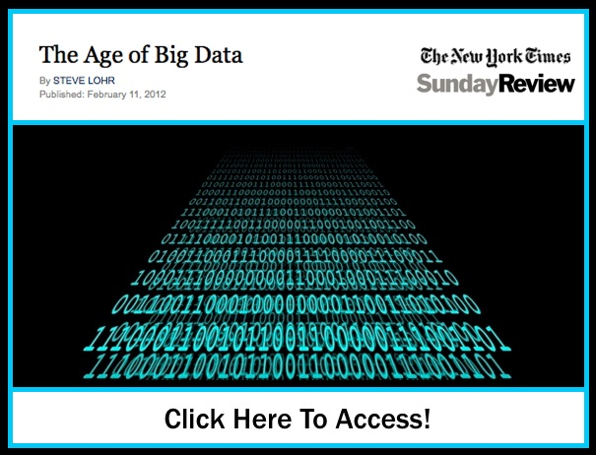
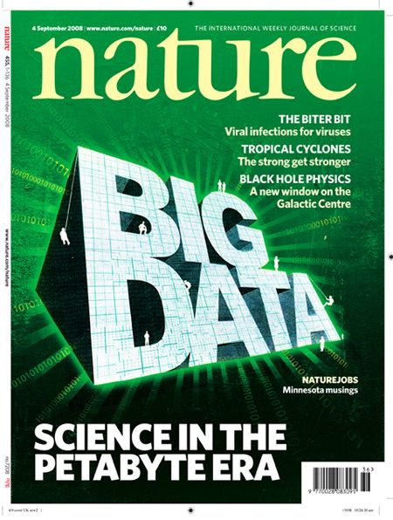
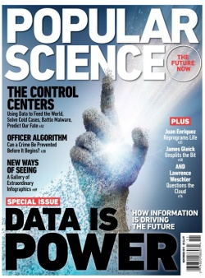
21st Century

Slide 9
21st Century
“I keep saying the sexy job in the next ten years will be statisticians. People think I'm joking, but who would've guessed that computer engineers would've been the sexy job of the 1990s?” - Hal Varian, Google’s Chief Economist

Slide 10
Hal Varian Explains…
“The ability to take data – to be able to understand it, to process it, to extract value from it, to visualize it, to communicate it's going to be a hugely important skill in the next decades, not only at the professional level, but even at the educational level for elementary school kids, for high school kids, for college kids. Because now we really do have essentially free and ubiquitous data.”
– Hal Varian

Slide 11
Data Science Success Stories

Slide 12


Slide 13
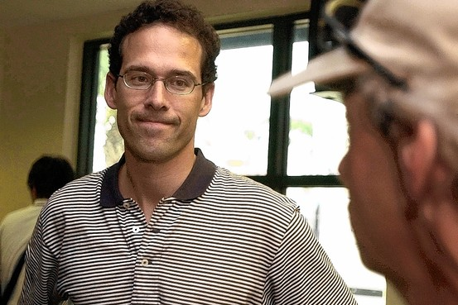
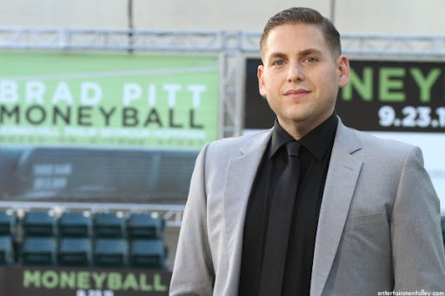
The Data Scientist
Actual
Hollywood

Slide 14
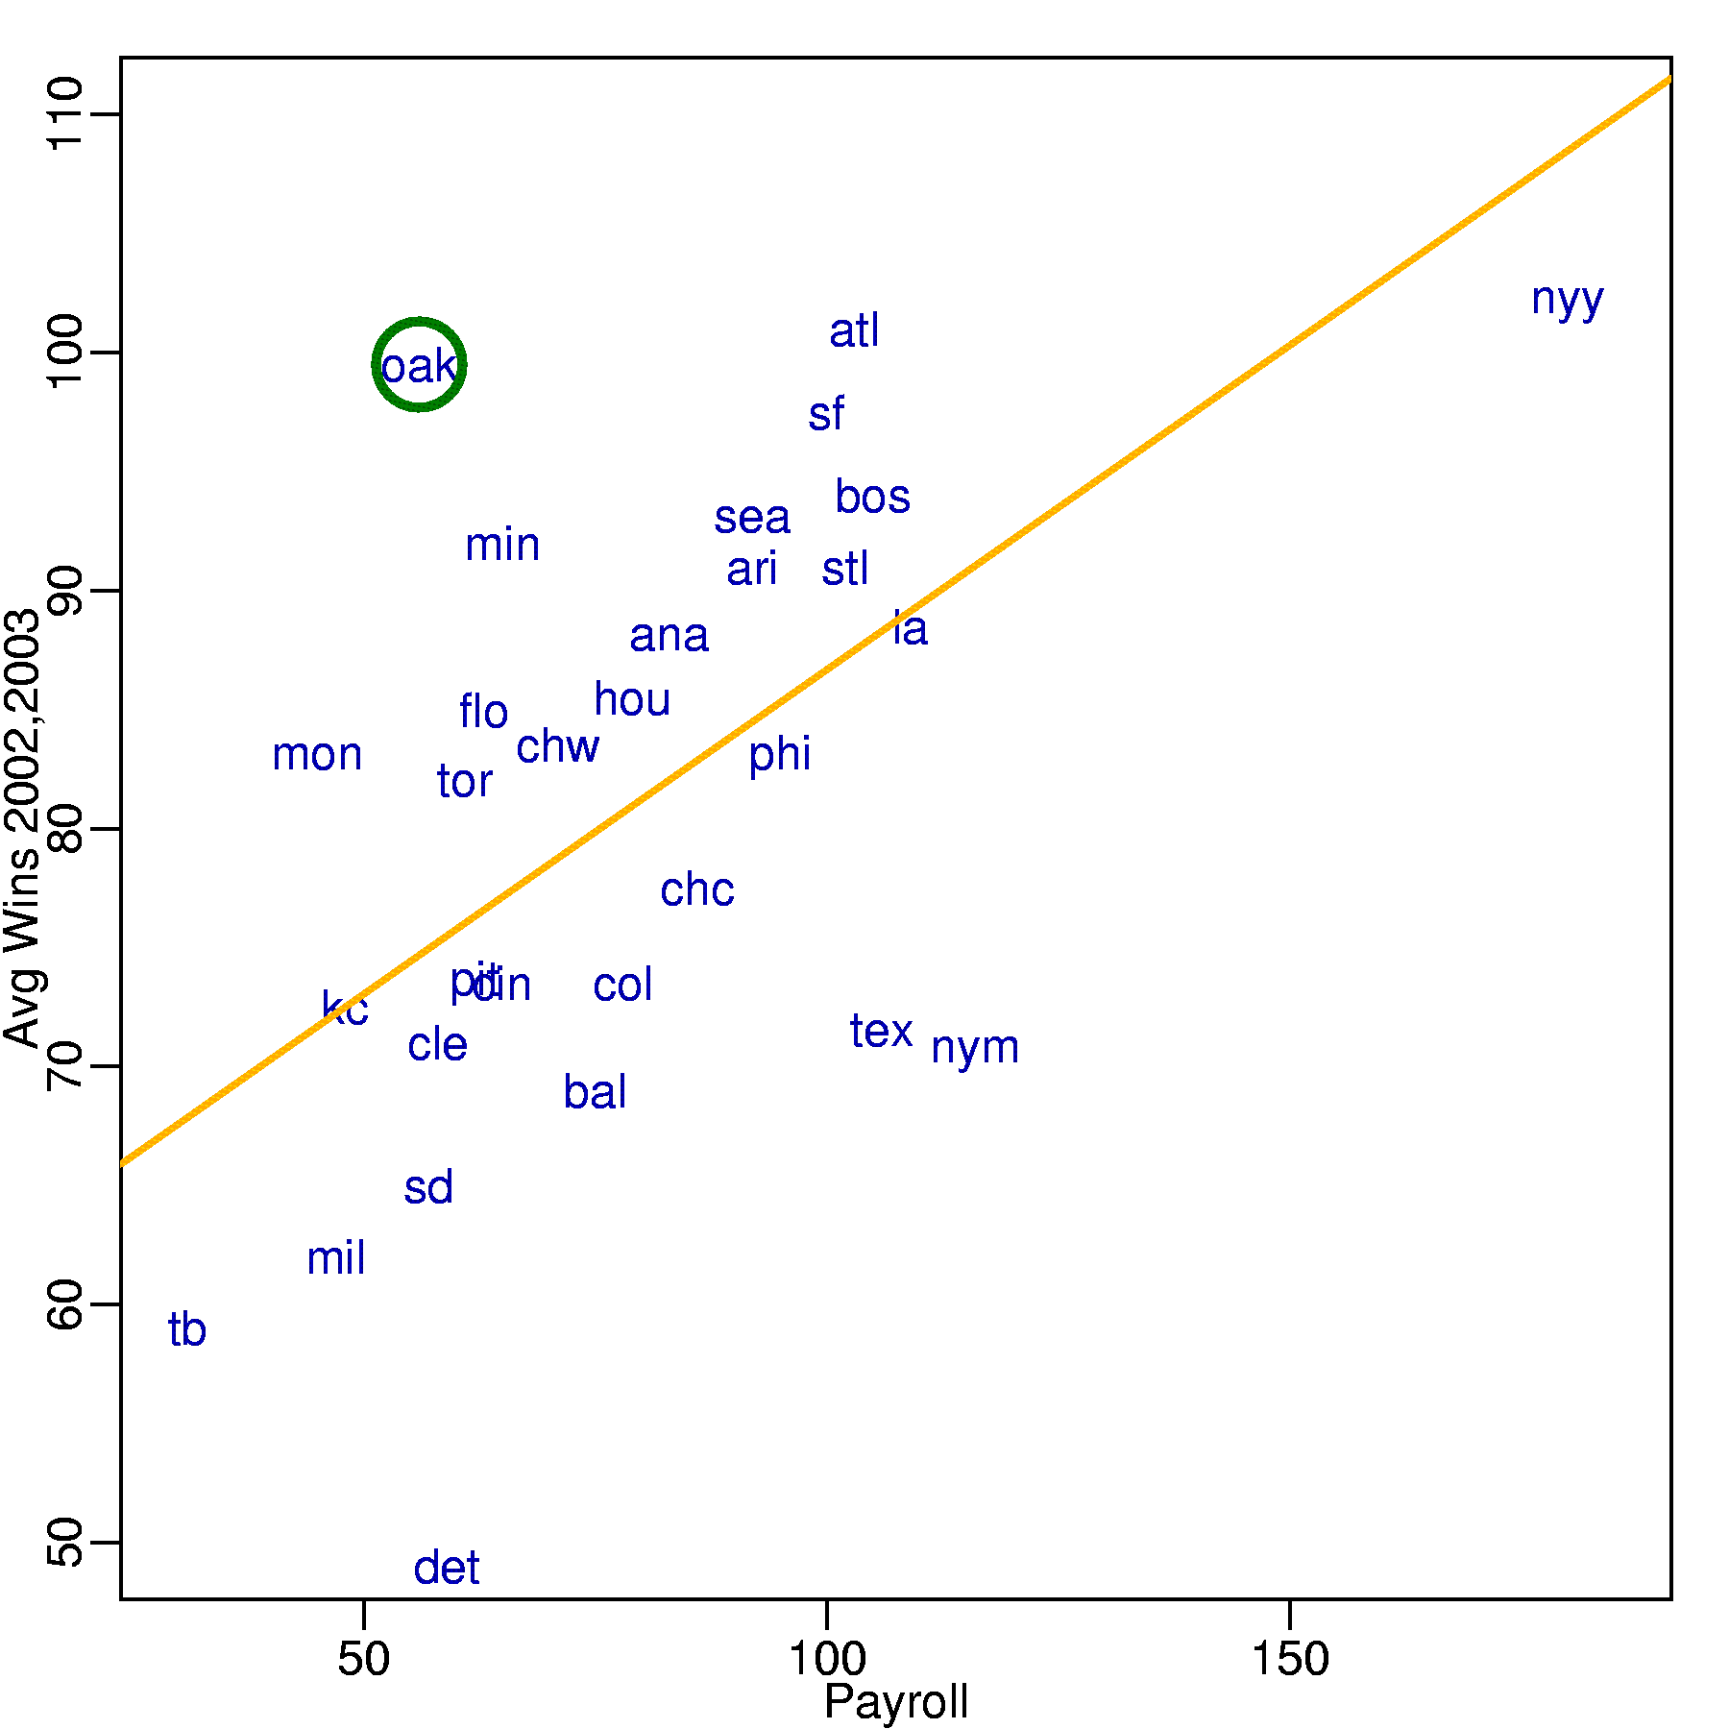
Money Ball
Starting around 2001, the Oakland A’s picked players that scouts thought were no good, but data said otherwise

Slide 15
“Nate Silver won the election” -Harvard Business Review
Predicted: 349 to 189, 6.1% difference
Actual: 365 to 173, 7.2% difference

Slide 16
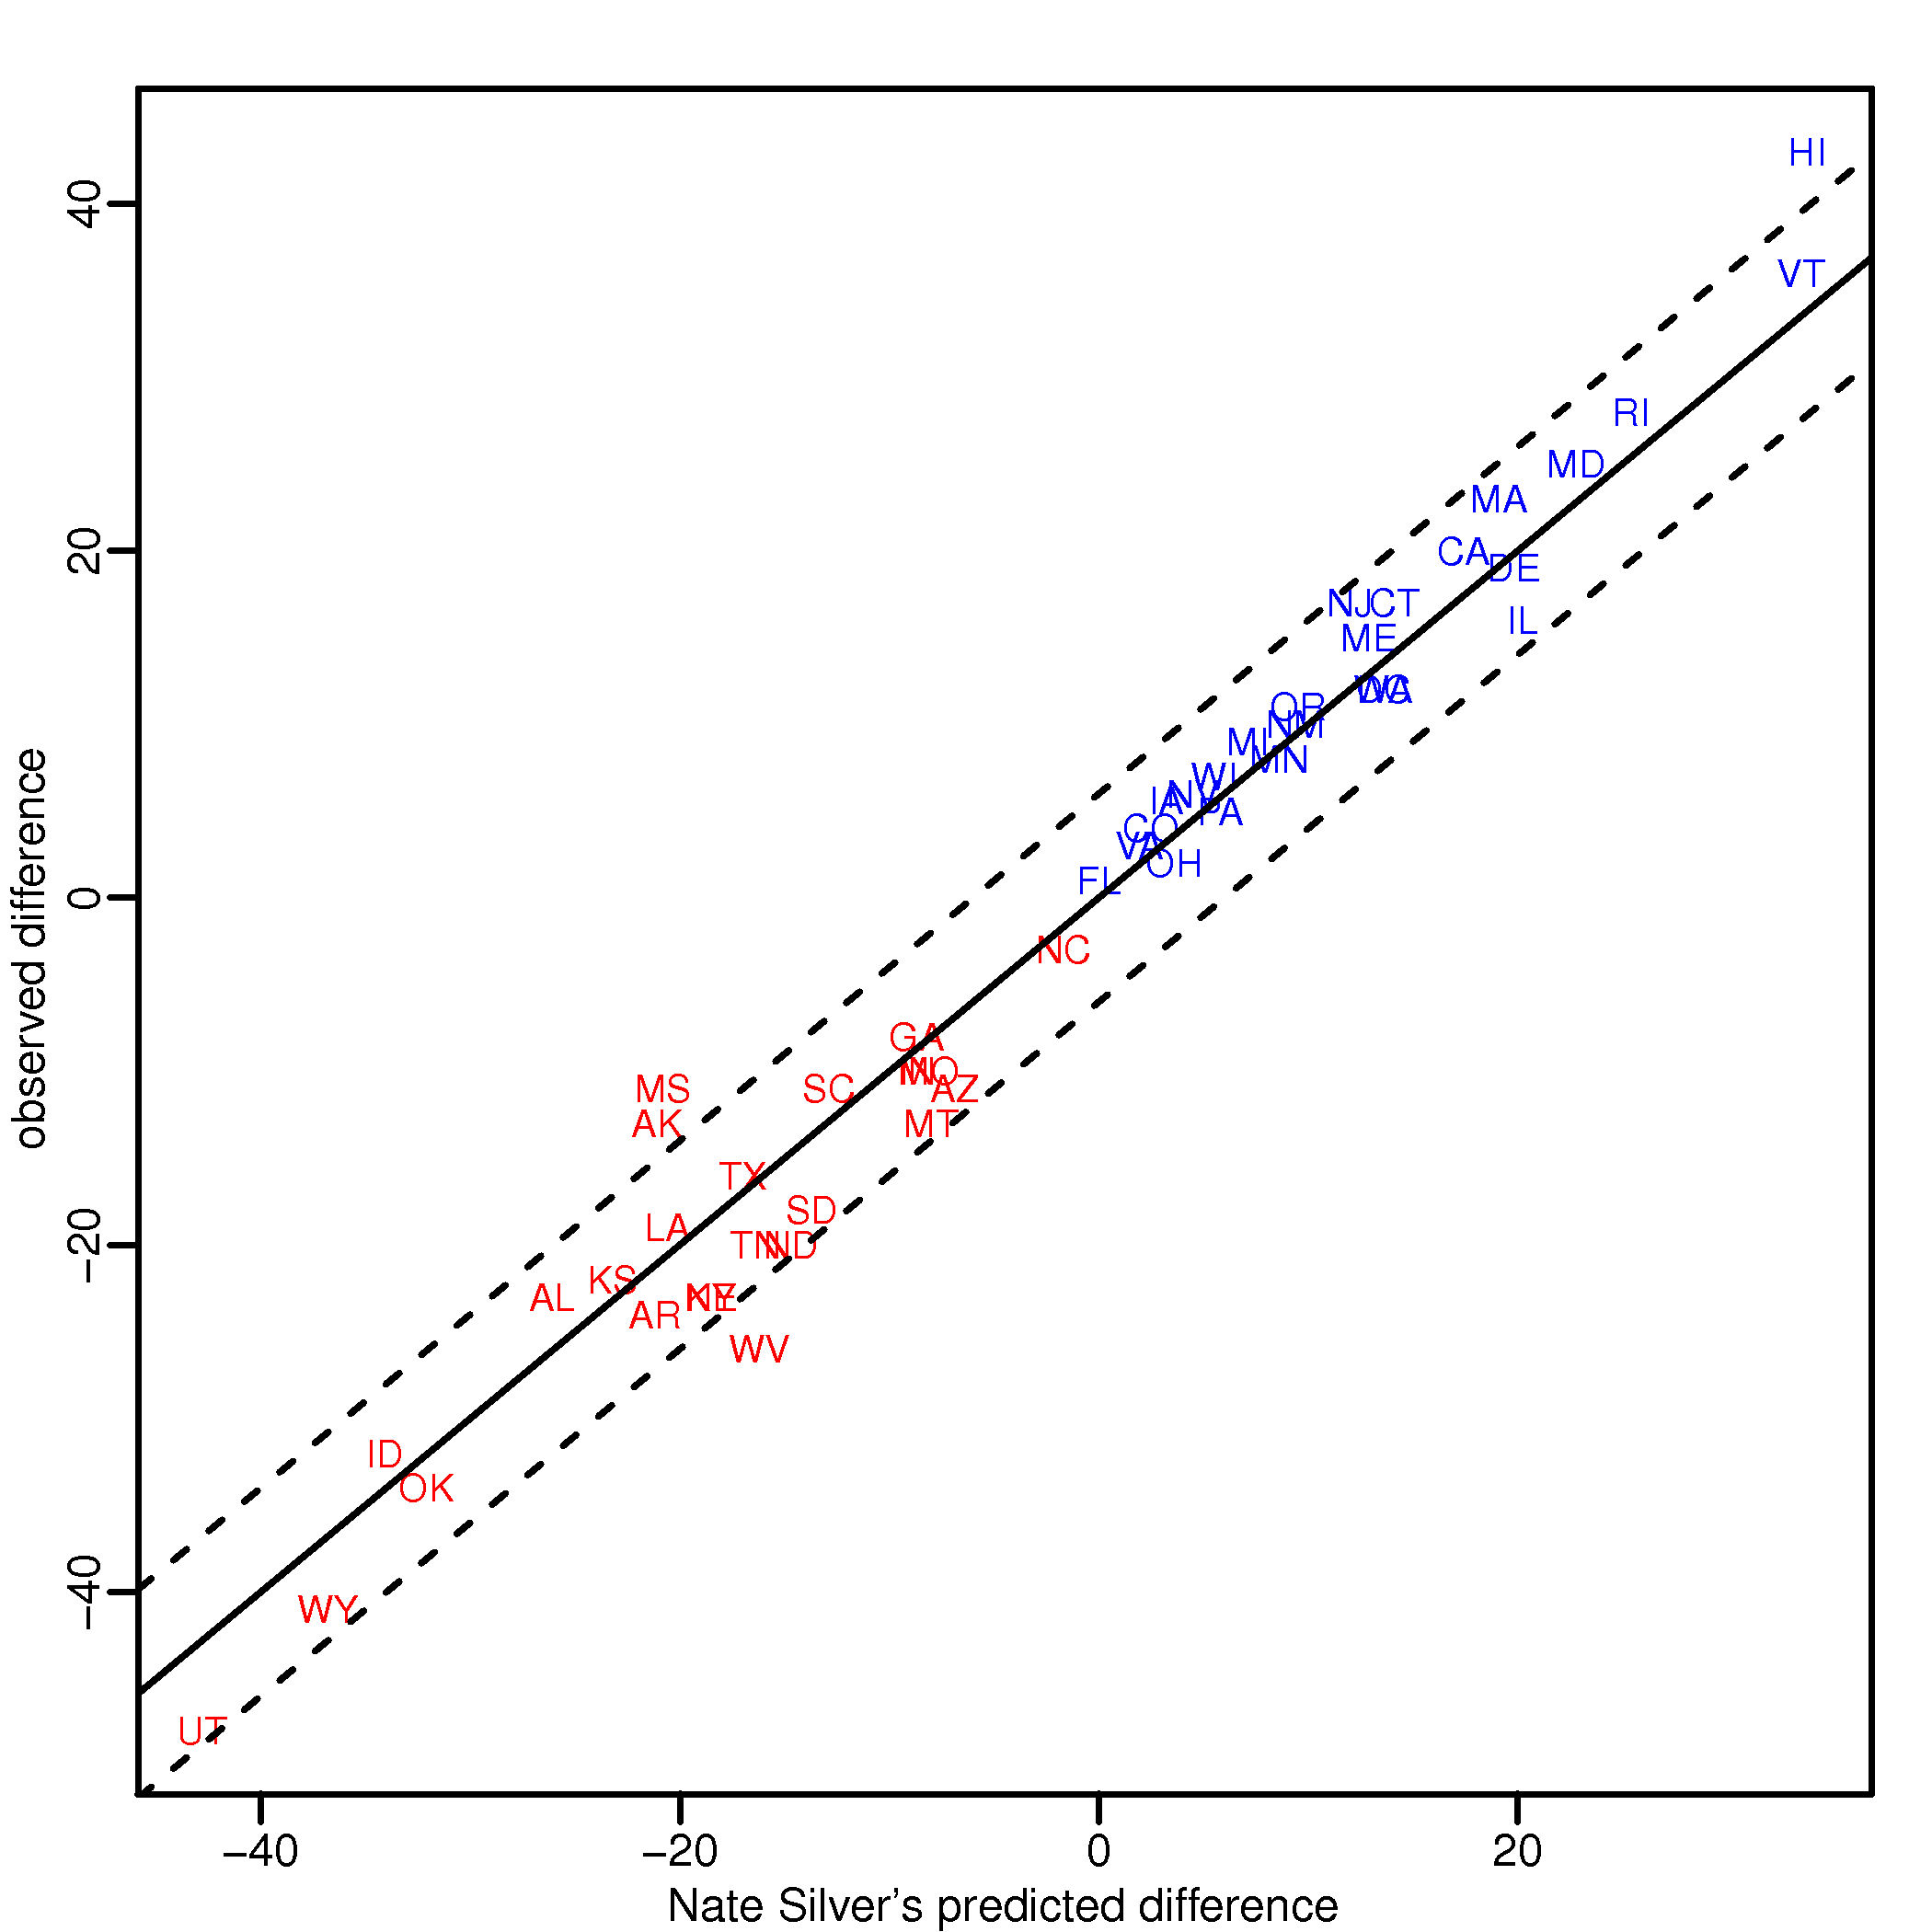
2012 Results

Slide 17
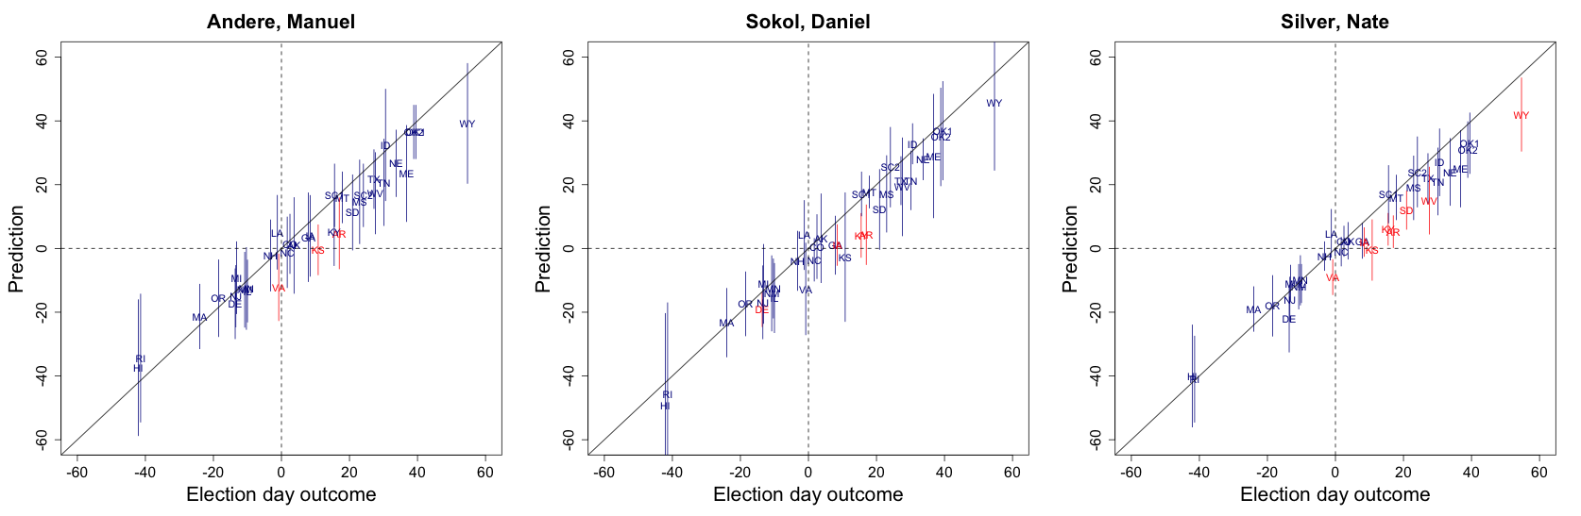
2014 Senate Race

Slide 18
Biology

Slide 19
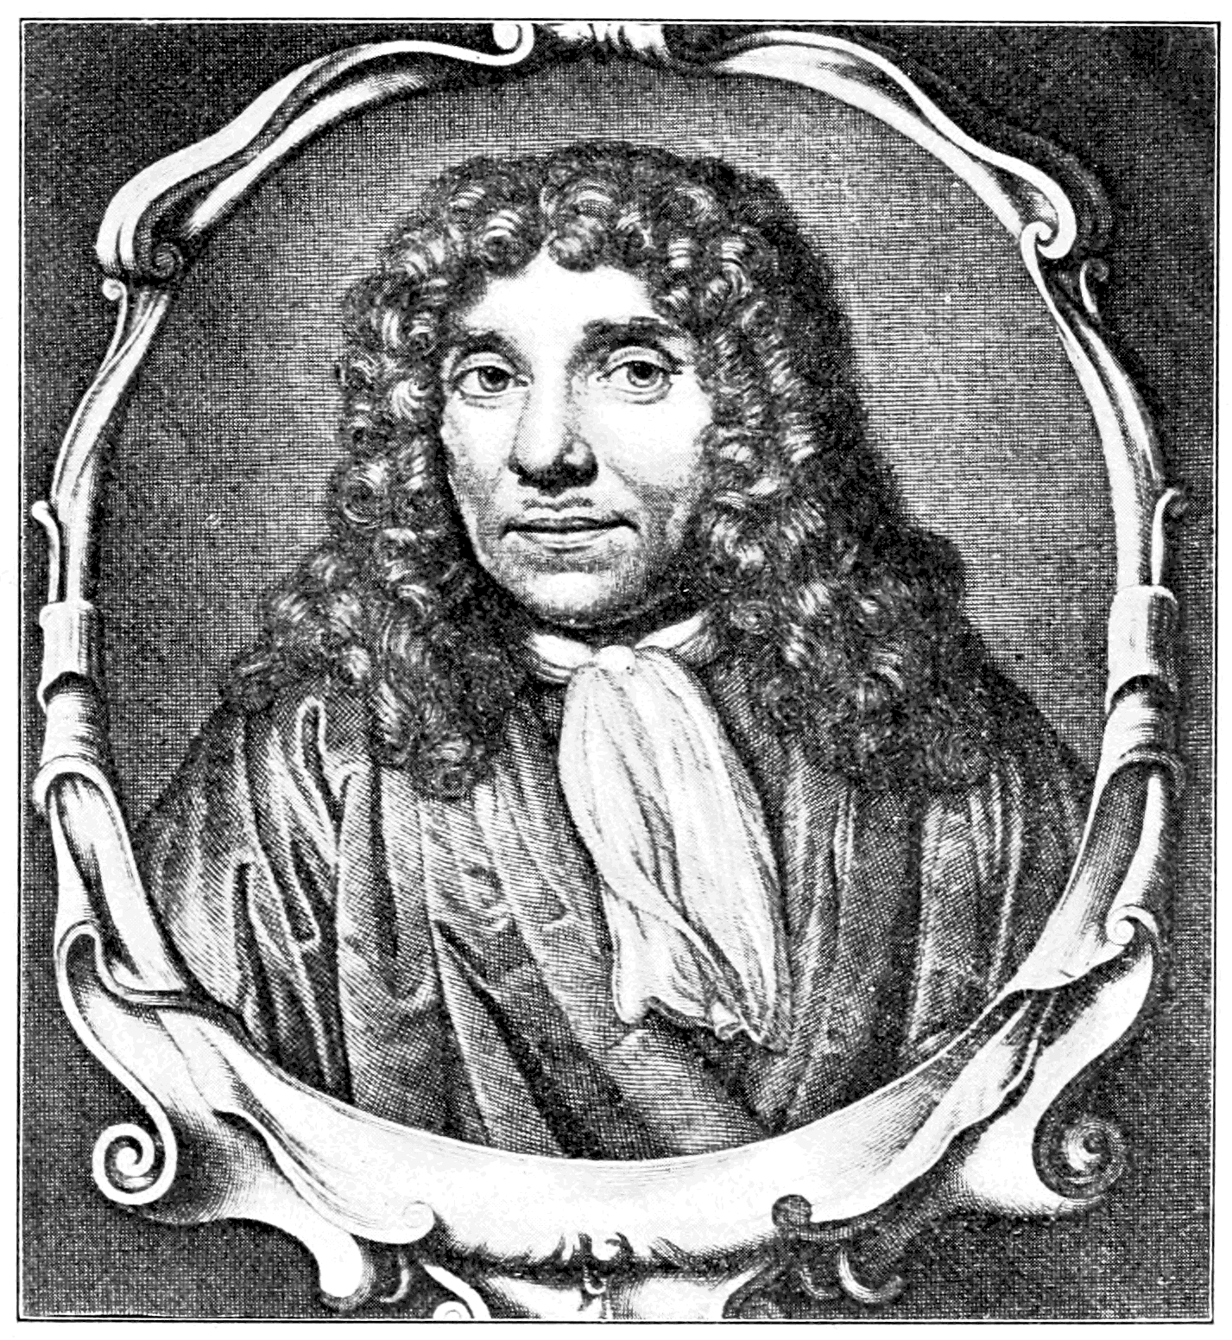
Anton Van Leeuwenhoek (1623-1723)
The “father of microbiology”

Slide 20
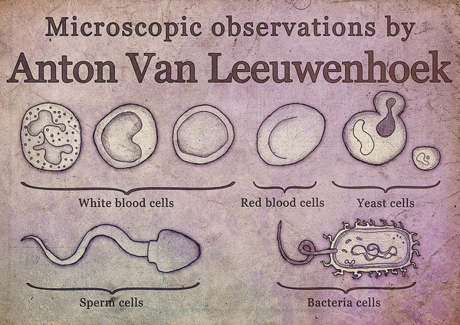
Some of his discoveries

Slide 21

By improving the microscope…

Slide 22
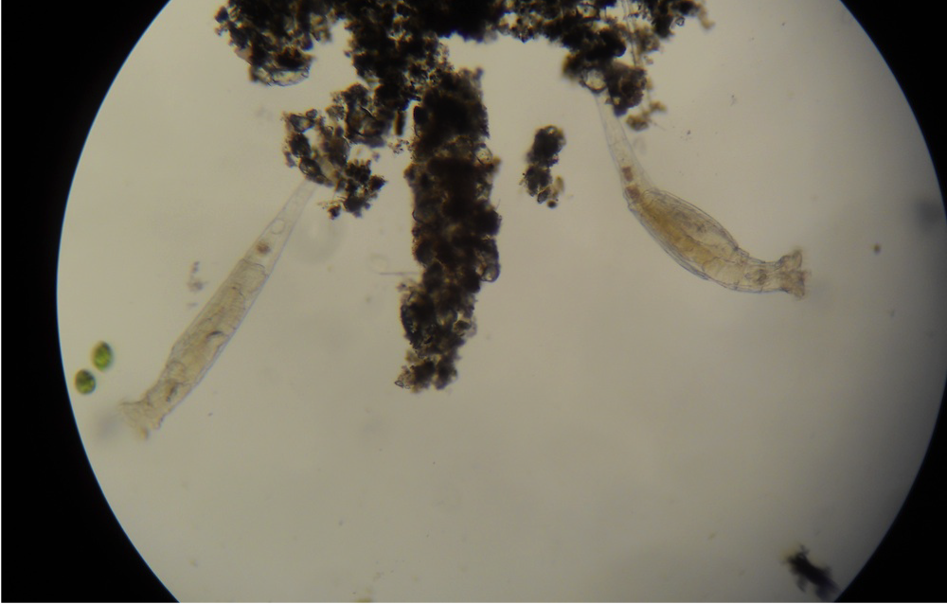
… he saw what others could not.

Slide 23
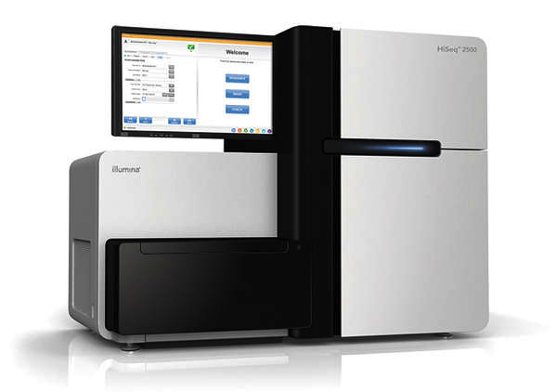
21st Century Version
Modern high-throughput technology
Our work has helped bring data into focus

Slide 24
21st Century Version
Modern high-throughput technology
Our work has helped bring data into focus

Slide 25
21st Century Version
Modern high-throughput technology
Our work has helped bring data into focus

Slide 26
Many other examples
Spellcheckers
Speech recognition
Language translators
Digitizing books
Social sciences
Medical diagnostics
Personalized medicine
Basic Biology

Slide 27
Course Team

Slide 28
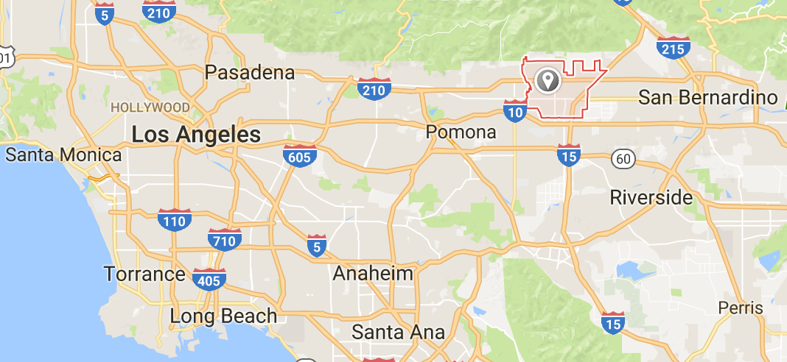

Heather Mattie
Instructor of Data Science
BS Math University of La Verne
MS Math Claremont Graduate University
PhD Biostats Harvard GSAS
Advisor: JP Onnela
Research centers on statistical network science and machine learning https://www.hsph.harvard.edu/onnela-lab/people/

Slide 29
TA Team
Daniel Briggs (dbriggs@hsph.harvard.edu)
Kareem Carr (kareemcarr@g.harvard.edu)
Irina Degtiar (idegtiar@g.harvard.edu)
Helian Feng (helian@g.harvard.edu)
Greyson Liu (gang_liu@g.harvard.edu)
Andy Shi (andyshi@g.harvard.edu)

Slide 30
Class Details

Slide 31
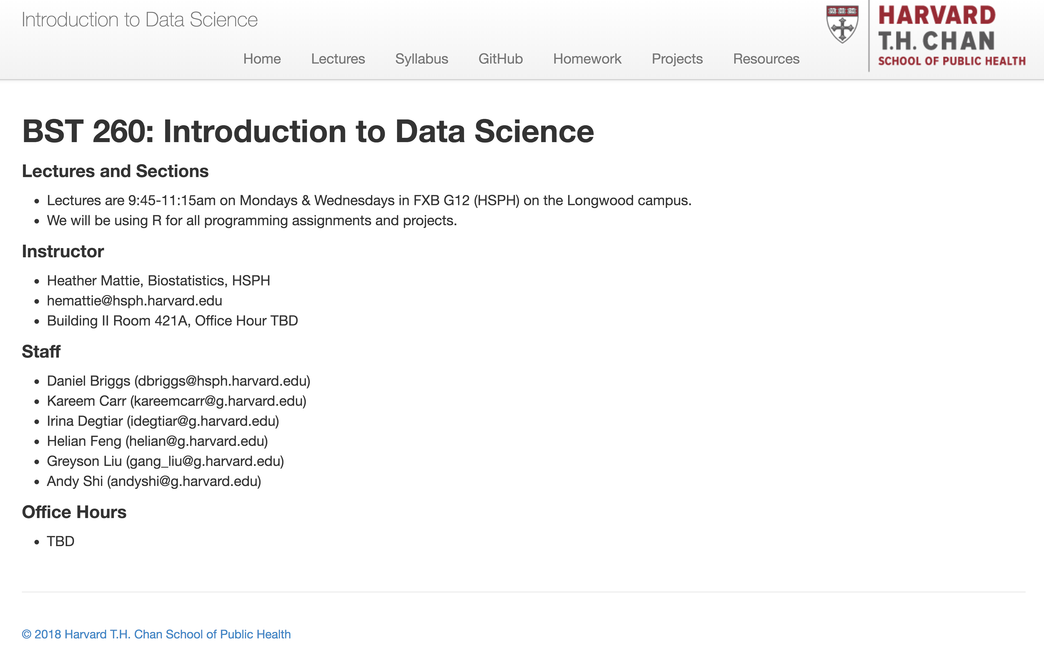
Course Communication: Slack Course Website: http://datasciencelabs.github.io/

Slide 32
Grading
Homework: 35%, assessed on 5 homework submissions
Two midterms: 30%, assessed on your individual submission
Final Project : 35%, assessed on meeting the project criteria
You are welcome to discuss the course’s ideas, material, and homework with others in order to better understand it, but the work you turn in must be your own

Slide 33
Homework
Real-world focus
Scrape and wrangle messy data
Explore data
Apply statistical analysis
Visualize and communicate results
Will be submitted via GitHub

Slide 34
Final Project
Teams of up to 4 students
Choose your own project
Part I: describe question and plan for answering
Process books, web sites, screencasts
Part II: present results and conclusions
Best project prizes!

Slide 35
How do we do Data Science?

Slide 36
Skills we will learn
Science: determining what questions can be answered with data and what are the best datasets for answering them
Computer programming: using computers to analyze data
Data wrangling: getting data into analyzable form on our computers
Statistics: separating signal from noise
Machine learning: making predictions from data
Communication: sharing findings through visualization, stories and interpretable summaries

Slide 37
Specific concepts and principles
Science: gain experience asking questions.
Computer programming: R, GitHub,
Data wrangling: R libraries for reading data tables and scrapping web pages.
Statistics: exploratory data analysis, inference, estimation, conditional probabilities, regression, modeling, Bayesian statistics, and more.
Machine learning: support vector machines, k-nearest neighbors, regression trees, random forests, boosting,
Communication: ggplot and in-class practice

Slide 38
Class will be centered around data
Homework and lectures will be based on:
Baseball data
World income and life expectancy
Gene expression data
Election data (predict primaries)
Data for building predictors
***Bring your laptop to class***

Slide 39
Choose your own final project
Examples of freely available data:
Genomics
Astronomy
Financial
Social media: Twitter, Reddit, Stack Overflow
Fitbit (get your own)
Baseball and other sports
Movie ratings
Baby names
To name a few…

Slide 40
What you need to do now
Download and install R and RStudio
Create a GitHub account
Complete survey on course website
Join Slack team
Explore the course website
Make friends with your classmates – you’ll need them for the final project ☺

